Slide 1





















Node 1
$$w_{12}^{0}$$
$$w_{1k}^{0}$$
$$w_{11}^{0}$$
thread$1$
$$w_{21}^{0}$$
$$w_{22}^{0}$$
$$w_{2k}^{0}$$
thread$2$
$$w^{1}=\frac{1}{64}\sum_{j=1}^{64}{w_{jk}^{0}}$$
$$∆w=w^{1}−w^{0}$$
$$w^{0}$$
…
Minibatch SGD
$$w_{63,1}^{0}$$
$$w_{63,2}^{0}$$
$$w_{63,k}^{0}$$
thread$63$
$$w_{64,1}^{0}$$
$$w_{64,2}^{0}$$
$$w_{64,k}^{0}$$
$$∆w$$
thread$64$
$${w^{0}=w}^{∗}−η∆w$$
Node 0 : Host $(w^{∗})$
Node 2
Node 3
……
Node 6
Node 7

Slide 2
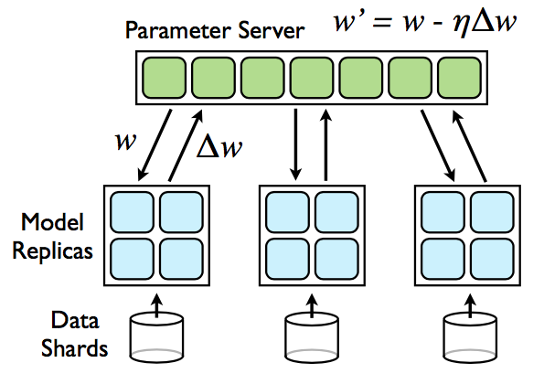
Downpour SGD. Model replicas asynchronously fetch parameters w and push $∆w$ to the parameter server.

Slide 3
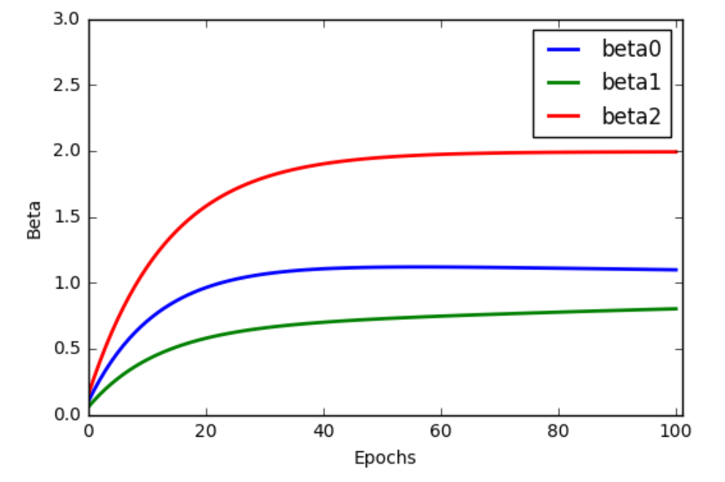

Slide 4
